Slide 1
Performance Analysis
Space Complexity: The space complexity of a program is the amount of memory it needs to run to completion.
Time Complexity: The time complexity of a program is the amount of computer time it needs to run to completion.

Slide 2
Space Complexity
A fixed part that is independent of the characteristics of the inputs and outputs. This part typically includes the instruction space, space for simple variables and fixed-size component variables, space for constants, etc.
A variable part that consists of the space needed by component variables whose size is dependent on the particular problem instance I being solved and the recursion stack space.
The space requirement S(P) of any program P is written as S(P) = c +Sp(I) where c is a constant and I represent Instance Characteristics.

Slide 3
When analyzing the space complexity of a program, we shall concentrate only on estimating Sp (instance characteristics).
For a given problem, we shall need to determine which instance characteristics to use to measure the space requirements and is problem specific.

Slide 4
Ex 1:
float add(float a, float b, float c) {
return a+b+c;
}
The problem instance is characterized by the specific values of a, b and c. Making assumption that one word is sufficient to store the values of a, b, c and the value returned by add, the space needed by function add is independent of the instance characteristics. Hence,
Sp(I)=0

Slide 5
Ex 2:
float sum(float a[], const int n){
float s=0;
for(int i=0;i<n;i++) s+=a[i];
return s;
}
Here n, the represents the instance characteristics ie number of elements to be summed. Since n is passed by value, one word must be allocated for it. Also, a is base address of the array, one word is to be allocated again for it. Hence, space needed by fn is independent of n and Sp(n) =0

Slide 6
Ex 3:
float rsum(float *a, const int n){
if (n<=0) return 0;
return (rsum(a,n-1)+a[n-1]);
}
Instances are characterized by n. Recursion stack space includes space for formal parameters, local variables and return address. Each call to rsum requires 12 bytes(space for n, a and return address). Space needed is 12(n+1).

Slide 7
Time Complexity
The time, T(P), taken by a program P is the sum of the compile time and the run (or execution) time. The compile time does not depend on the instance characteristics. We focus on the run time of a program, denoted by t_{p} (instance characteristics).

Slide 8
Program Step – a syntactically or semantically meaningful segment of a program that has an execution time that is independent of the instance characteristics.
The amount of computing represented by one step may be different from that represented by another step.
The time required to execute each statement that is counted as one step should be independent of the instance characteristics.
Eg: a=2 ;
a= 2*b+3/c;
return(a+b+c*d); - a program step

Slide 9
We can determine the number of steps a program needs to solve a problem instance by creating a global variable, count, which has an initial value of 0 and then inserting statements that increment count by the number of steps required by each executable statement.

Slide 10
Time Complexity in C++
General statements in a C++ program
  Step count
  Comments 0
  Declarative statements 0
  Expressions and assignment statements 1
  Iteration statements N
  Switch statement N
  If-else statement N
  Function invocation 1 or N
  Memory management statements 1 or N
  Function statements 0
  Jump statements 1 or N

Slide 11
Time Complexity Iterative Example
float sum (float *a, const int n)
{
float s = 0;
for (int i = 0; i < n; i++)
s += a[i];
return;
}

Slide 12
Step Count of Iterative Example
float sum (float *a, const int n)
{
float s = 0;
count++; // count is global
for (int i = 0; i < n; i++)
{
count++; // for for
s += a[i];
count++; // for assignment
}
count++; // for last time of for
count++; // for return
return;
}

Slide 13
Step Count of Iterative Example (Simplified)
void sum (float *a, const int n)
{
for (int i = 0; i < n; i++)
count += 2;
count +=3;
}
If initially count = 0, then the total of steps is 2n + 3.

Slide 14
Time Complexity of Recursive Example
float rsum (float *a, const int n)
{
if (n <= 0) return 0;
else return (rsum(a, n–1) + a[n-1]);
}

Slide 15
Step Count of Recursive Example
float rsum (float *a, const int n)
{
count++; // for if conditional
if (n <= 0) {
count++; // for return
return 0;
}
else {
count++; // for return
return (rsum(a, n–1) + a[n-1]);
}
}
Assume t_{rsum}(0) = 2
t_{rsum}(n) = 2 + t_{rsum}(n-1)
= 2 + 2 + t_{rsum}(n-2)
= 2*2 + t_{rsum}(n-2)
= 2n + t_{rsum}(0)
= 2n + 2

Slide 16
Matrix Addition Example
line void add (int **a, int **b, int **c, int m, int n)
1 {
2 for (int i = 0; i < m; i++)
3 for (int j = 0; j < n; j++)
4 c[i][j] = a[i][j] + b[i][j];
5 }

Slide 17
Step Count of Matrix Addition Example
void add (int **a, int **b, int **c, int m, int n)
{
for (int i = 0; i < m; i++)
{
count++; // for for i
for (int j = 0; j < n; j++)
{
count++; // for for j
c[i][j] = a[i][j] + b[i][j];
count++; // for assigment
}
count++; // for last time of for j
}
count++; // for last time of for i
}

Slide 18
Step Count of Matrix Addition Example (Simplified)
line void add (int **a, int **b, int **c, int m, int n)
{
for (int i = 0; i < m; i++)
{
for (int j = 0; j < n; j++)
count += 2;
count+2;
}
count++;
}
Step Count = 2mn+2m+1

Slide 19
Time Complexity (Cont.)
Note that a step count does not necessarily reflect the complexity of the statement.
Tabular Method:
Determine the step count for each statement. It is referred as Step per execution (s/e) - the amount by which count changes as a result of the execution of that statement.
Figure out the number of times that each statement is executed - frequency

Slide 20
Time Complexity Iterative Example
float sum (float *a, const int n)
1 {
2 float s = 0;
3 for (int i = 0; i < n; i++)
4 s += a[i];
5 return;
6 }
Line | s/e | Frequency | Total steps
1 | 0 | 1 | 0
2 | 1 | 1 | 1
3 | 1 | n+1 | n+1
4 | 1 | n | n
5 | 1 | 1 | 1
6 | 0 | 1 | 0
Total no. of steps |  |  | 2n+3

Slide 21
Step Table of Matrix Addition Example
Line | s/e | Frequency | Total steps
1 | 0 | 1 | 0
2 | 1 | m+1 | m+1
3 | 1 | m(n+1) | mn+m
4 | 1 | mn | mn
5 | 0 | 1 | 0
 | Total number of steps |  | 2mn+2m+1

Slide 22
Fibonacci Numbers
The Fibonacci sequence of numbers starts as 0, 1, 1, 2, 3, 5, 8, 13, 21, 34, 55, …
Each new term is obtained by taking the sum of the two previous terms. If we call the first term of the sequence F₀ then F₀ = 0, F₁ = 1, and in general
F_{n} = F_{n-1} + F_{n-2} , n ≥ 2.

Slide 23
C++ Program of Fibonacci Numbers
1 void fibonacci (int n)
2 // compute the Fibonacci number F_{n}
3 {
4 if (n <= 1) cout << n << endl; // F₀ = 0, and F₁ = 1
5 else { // compute F_{n}
6 int fn; int fnm2 = 0; int fnm1 = 1;
7 for (int i = 2; i <= n; i++)
8 {
9 fn = fnm1 + fnm2;
10 fnm2 = fnm1;
11 fnm1 = fn;
12 } // end of for
13 cout << fn << endl;
14 } // end of else
15 } // end of fibonacci

Slide 24
Step Count of Fibonacci Program
Two cases:
  n = 0 or n = 1
    Line 4 regarded as two lines: 4(a) and 4(b), total step count in this case is 2
  n > 1
    Line 4(a), 6, and 13 are each executed once
    Line 7 gets executed n times.
    Lines 8 – 12 get executed n-1 times each.
    Line 6 has s/e of 2 and the remaining lines have an s/e of 1.
    Total steps for the case n > 1 is 4n + 1

Slide 25
Asymptotic Notation
Determining step counts help us to compare the time complexities of two programs that compute the same function and to predict the growth in run time as the instance characteristics change.
But determining exact step counts could be very difficult. Since the notion of a step count is itself inexact, it may not be worth the effort to compute the exact step counts.
Definition [Big “oh”]: f(n) = O(g(n)) iff there exist positive constants c and n₀ such that f(n) ≤ cg(n) for all n, n ≥ n₀

Slide 26
Examples of Asymptotic Notation
3n + 2 = O(n)
  3n + 2 ≤ 4n for all n ≥ 2
100n + 6 = O(n)
  100n + 6 ≤ 101n for all n ≥ 10
10n² + 4n + 2 = O(n²)
  10n² + 4n + 2 ≤ 11n² for all n ≥ 5

Slide 27
Practical Complexities
If a program P has complexities O(n) and program Q has complexities O(n²), then, in general, we can assume program P is faster than Q for a sufficient large n.
However, caution needs to be used on the assertion of “sufficiently large”.

Slide 28
Function Values
log n | n | n log n | n² | n³ | 2^{n}
0 | 1 | 0 | 1 | 1 | 2
1 | 2 | 2 | 4 | 8 | 4
2 | 4 | 8 | 16 | 64 | 16
3 | 8 | 24 | 64 | 512 | 256
4 | 16 | 64 | 256 | 4096 | 65536
5 | 32 | 160 | 1024 | 32768 | 4294967296

Slide 29
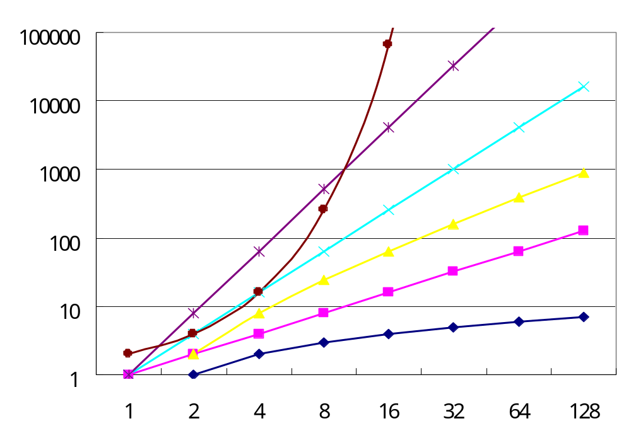
Plot of Function Values
2^{n}
n³
n²
nlogn
n
logn

